Slide 1
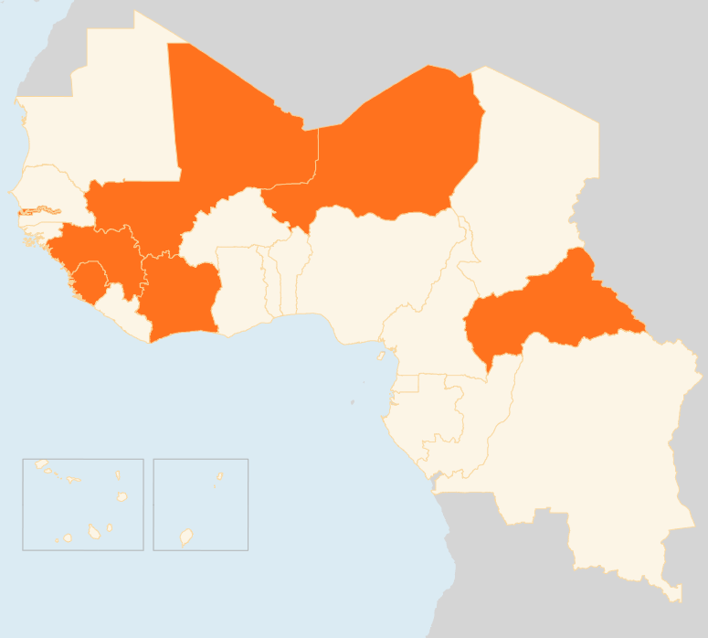


16 – 22 June 2015
CAR
DATE SET FOR ELECTIONS
The National Elections Authority announced that presidential and parliamentary elections will be held on 18 October, and a second round, if necessary, on 22 November. A month-long electoral census will start on 27 June to draw up a new voters roll. The elections are hoped to help restore order following the conflict triggered by the March 2013 ouster of president François Bozizé.
400,000 IDPs, NUMBERS DECREASE
According to the Population Movement Commission, the number of IDPs dropped to 399,268 in May from 426,238 in April. The figure includes 33,067 IDPs in 33 sites in Bangui. The returns are due to a relative improvement in security in some areas of the country, including in Bangui, and in particular the increased presence of MINUSCA forces in some areas of return. However, there are primary and secondary displacements, with the emergence of new IDP sites in Ouham and Nana-Gribizi provinces in the centre and northwest of the country.
COTE D’IVOIRE
16 KILLED BY FLOODING
Heavy rains in June have so far killed at least 16 people in the commercial capital Abidjan. Six of them died during the weekend of 20 - 21 June, according to the country’s civil protection agency. Most of the victims lived in shantytowns, where poorly-built houses cannot withstand the flooding during the June - August main rainy season.
NIGER
38 KILLED IN INSURGENT ATTACKS
On the night of 17-18 June, armed attackers killed 38 people during raids on Lamana, Boulamare and Goumao villages in Diffa Region near the border with Nigeria. The attackers burnt 80 percent of houses in Lamana and torched food stocks and machinery in Boulamare. The authorities blame Boko Haram for the attacks and have launched security operations in the area. Humanitarian actors and government officials undertook an assessment mission. The government has provided relief items, and WFP will distribute 72 tons of foodstuffs.
MALI
MAIN REBEL GROUP SIGNS PEACE AGREEMENT
On 20 May, northern Mali’s main Tuareg coalition, the Coordination of Azawad Movements (CMA), signed a peace agreement with the government following months-long negotiations. The Algiers agreement calls for the creation of elected regional assemblies but stops short of autonomy or federalism for northern Mali. The CMA had refused to sign the accord which was inked by other smaller rebel groups on 15 May. They finally agreed to commit to it after winning a stipulation that its fighters be included in a security force for the north, and for residents of the region to be represented better in government institutions.
EVD GUINEA/SIERRA LEONE
13 NEW CASES, SURVEILLANCE MEASURES REVAMPED
Guinea and Sierra Leone have launched enhanced Ebola surveillance and response measures. In Guinea, health checkpoints have been established in the western prefectures of Boké and Coyah. A scale-up of Ebola response continues in Sierra Leone’s hotspot districts of Kambia and Port Loko since the launch of a 21-day health operation in the two districts on 16 June. In the week to 21 June, three new cases were reported in Guinea and ten in Sierra Leone, according to provisional WHO data. A total of 24 cases were recorded in the week to 14 June.
MALI
MAIN REBEL GROUP SIGNS PEACE DEAL
NIGER
38
KILLED IN ARMED ATTACKS
CAR
399k
INTERNALLY DISPLACED PERSONS
EVD GUINEA/ SIERRA LEONE
COTE D’IVOIRE
16
KILLED BY FLOODS
13
NEW CASES, SURVEILLANCE REVAMPED
Creation date: 23 June 2015
Map data sources: UNCS, DevInfo, OCHA.
The boundaries and names shown and the designations used on this map do not imply official endorsement or acceptance by the United Nations

